Slide 1
UT-Assert Training
Charles Zogby
charles.a.zogby@nasa.gov
301-286-8541

Slide 2
Agenda
1.) UT-Assert Overview
2.) What’s Included in the UT-Assert Library
3.) Test Structure
a.) Flowchart
b.) Required Test Files
c.) Test Runner
i.) Adding Test Cases
ii.) Running Test Cases
d.) Setup / Teardown Functions
e.) Test Cases
4.) Writing Test Cases
a.) Structure
b.) Assert Statements
c.) Stub Functions
d.) Hook Functions
5.) Makefile
6.) Test Suite Execution
7.) Test Output
8.) Walkthrough: Example cFS Application Test Suite
9.) Walkthrough: Actual cFS Application Test Suite

Slide 3
UT-Assert Overview
Used for unit testing cFS applications and tasks through the use of assert statements
An assert statement evaluates whether a condition is true or false and returns PASS or FAIL.
Each test case should be self-verifying, rather than needing to be manually verified after running
Used to test functionality and code coverage of every function in an application, one at a time
Each test should be completely independent from other tests
Each test case should test ONLY its designated function/operation
Results of sub-functions do not need to be tested – tested in separate test case for each sub-function
All cFS API library functions (OSAL, PSP, and cFE) are automatically substituted with UT-Assert stub and hook functions
Every cFS API library function has a corresponding UT-Assert stub function
Tests can set individual stub functions to behave in 3 different ways:
1.) Return its default return value (usually CFE_SUCCESS)
2.) Return a specified custom value
3.) Execute a specified custom hook function and then return the resulting return value
Some cFS API library functions have corresponding hook functions that are called by default
Can be substituted for a custom hook function or a custom return value

Slide 4
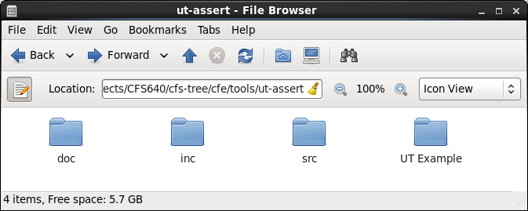
What’s Included in the Library
/src: Contains the library source files
/inc: Contains the header files for the library source files
/doc: Contains documentation about UT-Assert
Note: current documentation is incomplete and outdated
Will be replaced by this presentation
/UT Example: Contains an example UT-Assert unit test suite (and the app it tests)

Slide 5
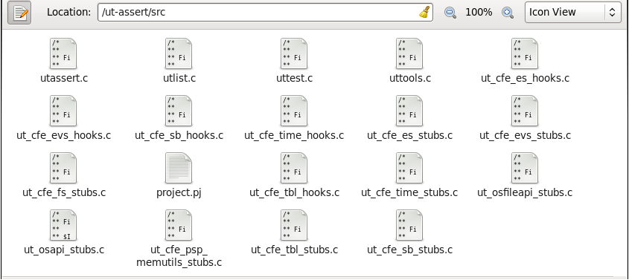
What’s Included in the Library
Contents:
utassert.c /.h – defines the standard assert function, along with a few related functions
utlist.c – defines functions to create linked lists, which are used elsewhere in the library
uttest.c – defines the functions used to add and run test cases
uttools.c – defines miscellaneous functions that are useful for unit testing
ut_cfe_***_stubs.c – defines the stub functions for a particular cFS component, and supporting functions
ut_cfe_***_hooks.c – defines the default hook functions for a particular cFS component

Slide 6
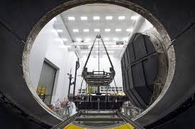
Test Structure

Slide 7
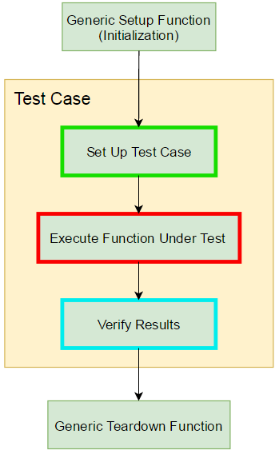
Test Structure: Test Case Flowchart

Slide 8
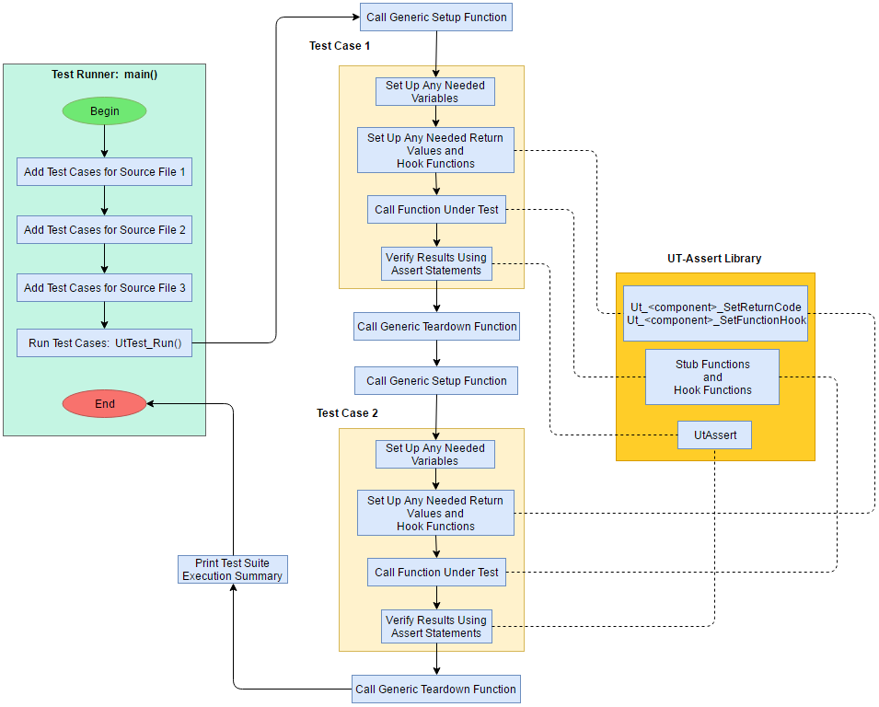
Test Structure: Full Flowchart

Slide 9
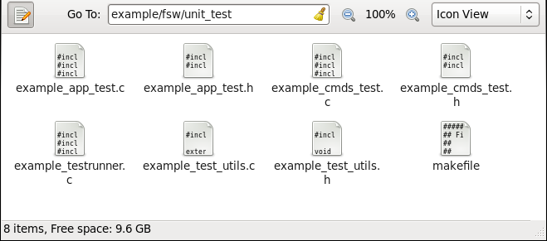
Test Structure: Required Test Files
For the example application:
<source file name>_test.c / .h: defines the unit test cases for all functions in a particular source file
<app name>_test_utils.c / .h: defines miscellaneous test functions (Setup, Teardown, etc)
<app name>_testrunner.c: defines the main function, which adds all test cases and runs them
makefile: standard makefile functionality

Slide 10
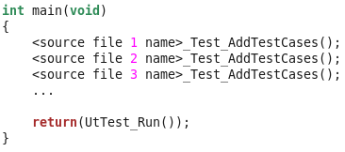
Test Structure: Test Runner
<project>_testrunner.c
Top-level function for running the entire test suite
Adds all test cases for each source file under test
Runs all test cases

Slide 11
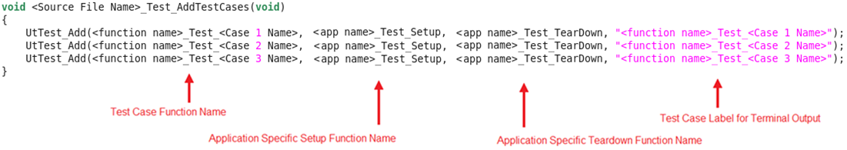
Test Structure: Test Runner
Adding Test Cases
Test runner adds all test cases for a particular file via <source file name>_Test_AddTestCases
Written by the user
<source file name>_Test_AddTestCases adds each case via UT-Assert function UtTest_Add

Slide 12
Test Structure: Test Runner
After all test cases are added, Ut-Assert library function “UtTest_Run” is called
Called only once, which executes all test cases
For each of the previously-added test cases:
Prints “Running Test: <test case name>”
Calls specified Setup function
Calls test case function
Each assert in test case will print “PASS: <assert label>” or “FAIL: <assert label>”
If assert passes, increments count of passed asserts; else increments count of failed asserts
Increments count of tests executed
Calls specified Teardown function
Prints “Tests Executed: <count of executed tests>”
Prints “Assert Pass Count: <count of passed asserts>”
Prints “Assert Fail Count: <count of failed asserts>”

Slide 13
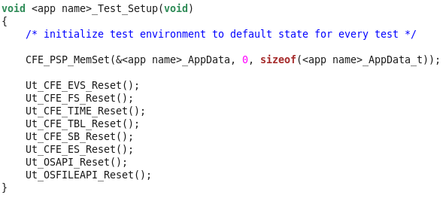
Test Structure: Test Runner
Setup Function:
A single user-written initialization function automatically called before each test case is run
Initializes to default conditions before each test case
Same function called for every test case in the test suite
Teardown Function:
Similar to the Setup Function, but called AFTER each test case
Both are defined in ***_test_utils.c
Example setup function:

Slide 14
Test Structure: Test Cases
Written by the user
Tests a single condition, branch of code, etc, using assert statements
Tests functionality and code coverage of each function in an application, one at a time
Only needs to test the designated section of code
Sub-functions are tested in separate test cases

Slide 15

Writing Test Cases

Slide 16
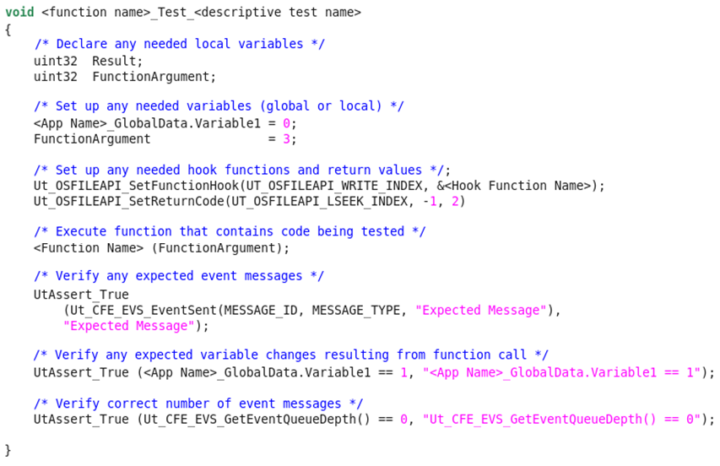
Writing Test Cases: Basic Structure
Set Up Test Case
Execute Function Under Test
Verify Results

Slide 17
Writing Test Cases: Assert Statements
An assert statement evaluates whether a condition is true or false and returns PASS or FAIL.
For frequently-used groups of assert statements, it is recommended to write custom function
Any code changes would then only need to be changed in one place
Multiple types of assert are defined via macros
Only one assert type is necessary (UtAssert_True), but others can be useful

Slide 18
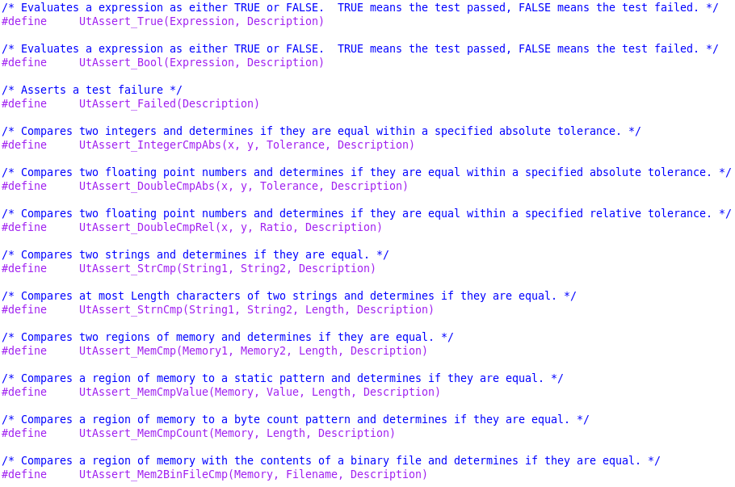
Writing Test Cases: Assert Statements
Other assert types:

Slide 19
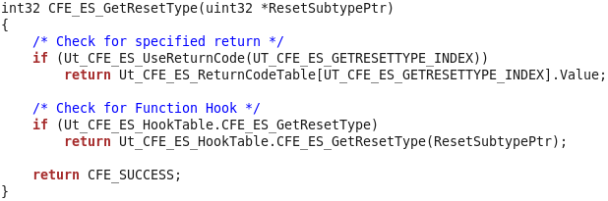
Writing Test Cases: Stub Functions
Stub functions replace calls to corresponding cFS API library function
Stub Function Example:
Setup Example:
To set stub function to return a custom return value:
Ut_CFE_ES_SetReturnCode(UT_CFE_ES_GETRESETTYPE_INDEX, Value, CallCountToReturnOn);
To set stub function to call a custom hook function:
Ut_CFE_ES_SetFunctionHook(UT_CFE_ES_GETRESETTYPE_INDEX, &HookFunctionName);

Slide 20
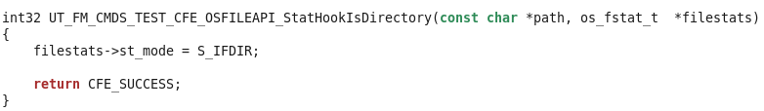
Writing Test Cases: Hook Functions
A hook function can be written and set to be called by a stub function
Replaces a UT-Assert function’s code with alternate code for testing purposes
If no hook function, UT-Assert function only calls empty stub, which only returns a value
UT-Assert library includes default hook functions for some cFS API functions
Defined in files ending in “hooks.h” / “hooks.c”
Example case: Need to set a variable

Slide 21
Makefile
Quickest way to create new makefile:
1.) Copy from UT-Assert Example or another CFS App UT-Assert Unit Test
2.) Modify the makefile to be correct for new test suite
Contents of makefile:
Paths to source files
Object files to compile from source files
Name of test runner executable
Compiler and linker options
Rules to make targets (all, run, gcov, clean)
Note: there may be issues running gcov built code in a debugger
C compiler rule

Slide 22
Test Suite Execution
1.) Open a terminal window in the unit_test directory
2.) “make clean”
3.) “make” (runs default “make all”)
4.) “make run” (or ./<test suite executable name>)
5.) “make gcov” (optional – gets gcov code coverage results)
Note: these assume makefile is properly set up

Slide 23
Test Output
Test results and gcov coverage results are displayed in terminal window
User should manually copy to output log: <projectname>_test_log.txt
Line-by-line code coverage detailed in .gcov files generated when gcov is run
It is recommended that a README file be written, using a previous test README file as an guideline
Output example:
Running Test: FM_InvokeChildTask_Test_WriteIndexEqualsQueueDepth
PASS: FM_GlobalData.ChildWriteIndex == 0
PASS: FM_GlobalData.ChildQueueCount == 1
PASS: Ut_CFE_EVS_GetEventQueueDepth() == 0
Running Test: FM_AppendPathSep_Test
PASS: strncmp(Directory, 'directory/', OS_MAX_PATH_LEN) == 0
PASS: Ut_CFE_EVS_GetEventQueueDepth() == 0
Tests Executed: 178
Assert Pass Count: 679
Assert Fail Count: 0
gcov: '../src/fm_tbl.c' 100.00% 52
gcov: '../src/fm_child.c' 100.00% 481
gcov: '../src/fm_app.c' 100.00% 120
gcov: '../src/fm_cmds.c' 100.00% 285
gcov: '../src/fm_cmd_utils.c' 100.00% 174

Slide 24
Additional Features
Preprocessor Macro Options
UT_VERBOSE (default = true)
Determines whether or not to print less-important messages to the terminal
UT_VERBOSE_TEST_NAME (default = false)
If UT_VERBOSE = false, determines whether or not to print test names
UT_STOP_ON_ASSERT_FAILURE (default = false)
Determines whether or not to stop execution of entire test suit if a single test case fails
UtPrintf:
Like printf, but only prints if UT_VERBOSE = true
UtSprintf:
Like sprintf, but returns the string instead of using pointer

Slide 25
Walkthrough: Example cFS Application Test Suite
Source files to walk through:
example_testrunner.c
example_test_utils.c
example_app_test.c
example_cmds_test.c
Other files to walk through:
example_test_log.txt
README.txt

Slide 26
Walkthrough: Actual cFS Application Test Suite
Source files to walk through:
fm_testrunner.c
fm_test_utils.c
fm_app_test.c
fm_child_test.c
fm_cmds_test.c
fm_cmd_utils_test.c
Other files to walk through:
fm_test_log.txt
README.txt

Slide 27
Useful Tips
For frequently-used groups of assert statements, it is recommended to write custom function
Any code changes would then only need to be changed in one place
Use existing UT-Assert projects as reference for new projects
If gcov causes problems when running in debugger:
Change makefile:
Replace lines for GCOV_COPT and GCOV_LOPT with:
ENABLE_GCOV = FALSE
ifeq ($(ENABLE_GCOV), TRUE)
GCOV_COPT = -fprofile-arcs -ftest-coverage -pg -p
GCOV_LOPT = -pg -p -fprofile-arcs -ftest-coverage -lgcov
endif

Slide 28
How to Get the UT-Assert Library
Integrity 2010 FSW_TOOLS repository
Code 582 FSB Document Repository
https://fsb.gsfc.nasa.gov/CFS/
Under Baselined Documents / Releases
cFS NASA wide community Babelfish git repository
Sourceforge
https://sourceforge.net/projects/cfs-ut-assert/

